Slide 1
Deploying a Model for Inference at Production Scale
Notes:
Today, we’re going to be talking about Production Model Deployment. It takes a lot of patience and dedication to develop a machine learning model, and it turns out, making that model available to hundreds, thousands, or even millions of users can be an equally interesting challenge. It’s a lot like putting on a theatrical performance. Our models tend to work with other tools and actors to put on a live show, and demanding audiences expect a quality performance. If the stage front is our application that our audience interacts with, then there are a variety of engineers that work backstage to ensure that the show must go on.

Slide 2
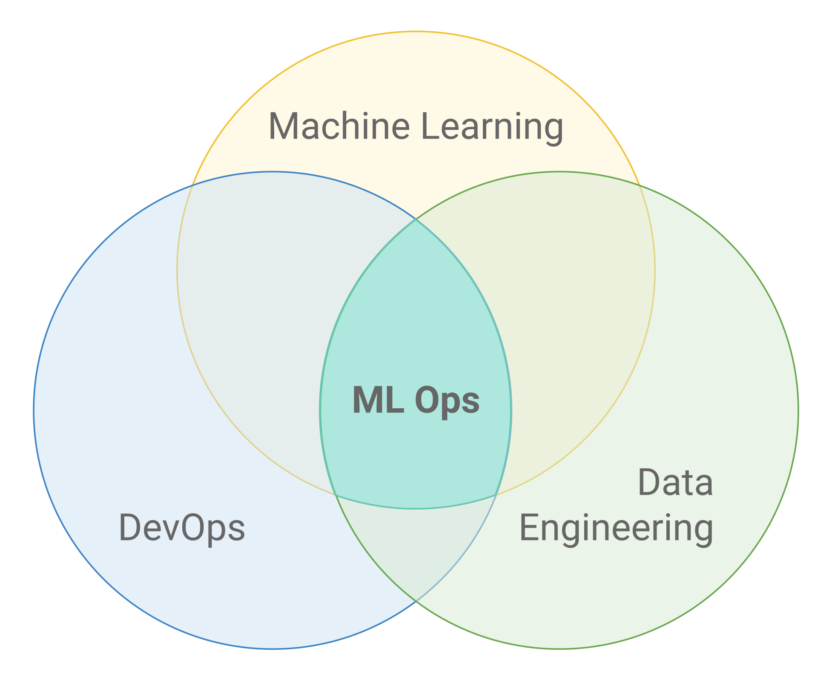
MLOPS
Operationalizing ML Training and Inference
Data Preparation, Feature Engineering
Data, Model, Environment, Parameters Versioning For Reproducibility
Central Storage For Security & Collaboration
Experiments, Track & Compare Results
Model Validation
Deployment Of Models & Pipelines In Production
Source: https://towardsdatascience.com/ml-ops-machine-learning-as-an-engineering-discipline-b86ca4874a3f
Monitoring Accuracy & Performance
Retraining
Notes:
Let’s go over some of the backstage technicians that make the show possible.
There are Data Engineers who curate data for analysis. There are Machine Learning Engineers and Data Scientists who experiment with model architectures and training to make sure models are performant. There are also DevOps Engineers, people who specialize in deploying production code and applications. All of these people work together to form ML Ops, the operation of end-to-end model development and deployment.
Quite often, there is some overlap between these roles, and that’s intended. Each engineer can better optimize their work the better they understand the work of their teammates. This also adds to the model reliability as more people will have insight into finding a fix on the small chance something breaks in production.
Very large teams might have even more specialized roles such as Data Quality Engineers, Test Engineers, or Site Reliability Engineers.

Slide 3




AI DEVELOPMENT AND DEPLOYMENT WORKFLOW
Data Scientist | ML Researcher
ML, Data Engineer, MLOps
App Developer
DevOps | MLOps | Infrastructure Ops*
Model Development
Model Training, Production Integration
Model Integration in Applications
Model, Application Deployment
Monitoring
Retraining
Infrastructure Engineers
Design | Build | Support
* IInfrastructure engineer, SRE, Sysadmin
Notes:
A typical workflow between all these engineers might be something like this:
A data scientist might sample data from a data store and experiment on potentially useful machine learning models. Once they settle on something promising, they’ll work together with the data engineer to train on a larger sample of the data and setup an automated workflow to schedule model training as new data comes in. Meanwhile, the data scientist will also reach out to an application developer to integrate the new model as a feature in an application. Once the application developer has a clear idea of how this feature will work, they’ll reach out to DevOps to work on a launch plan such as what testing needs to be done and how much server resources they expect to need.

Slide 4

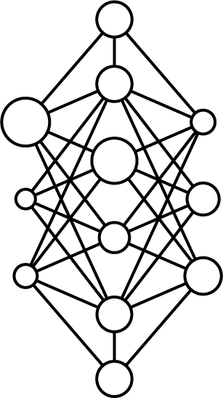

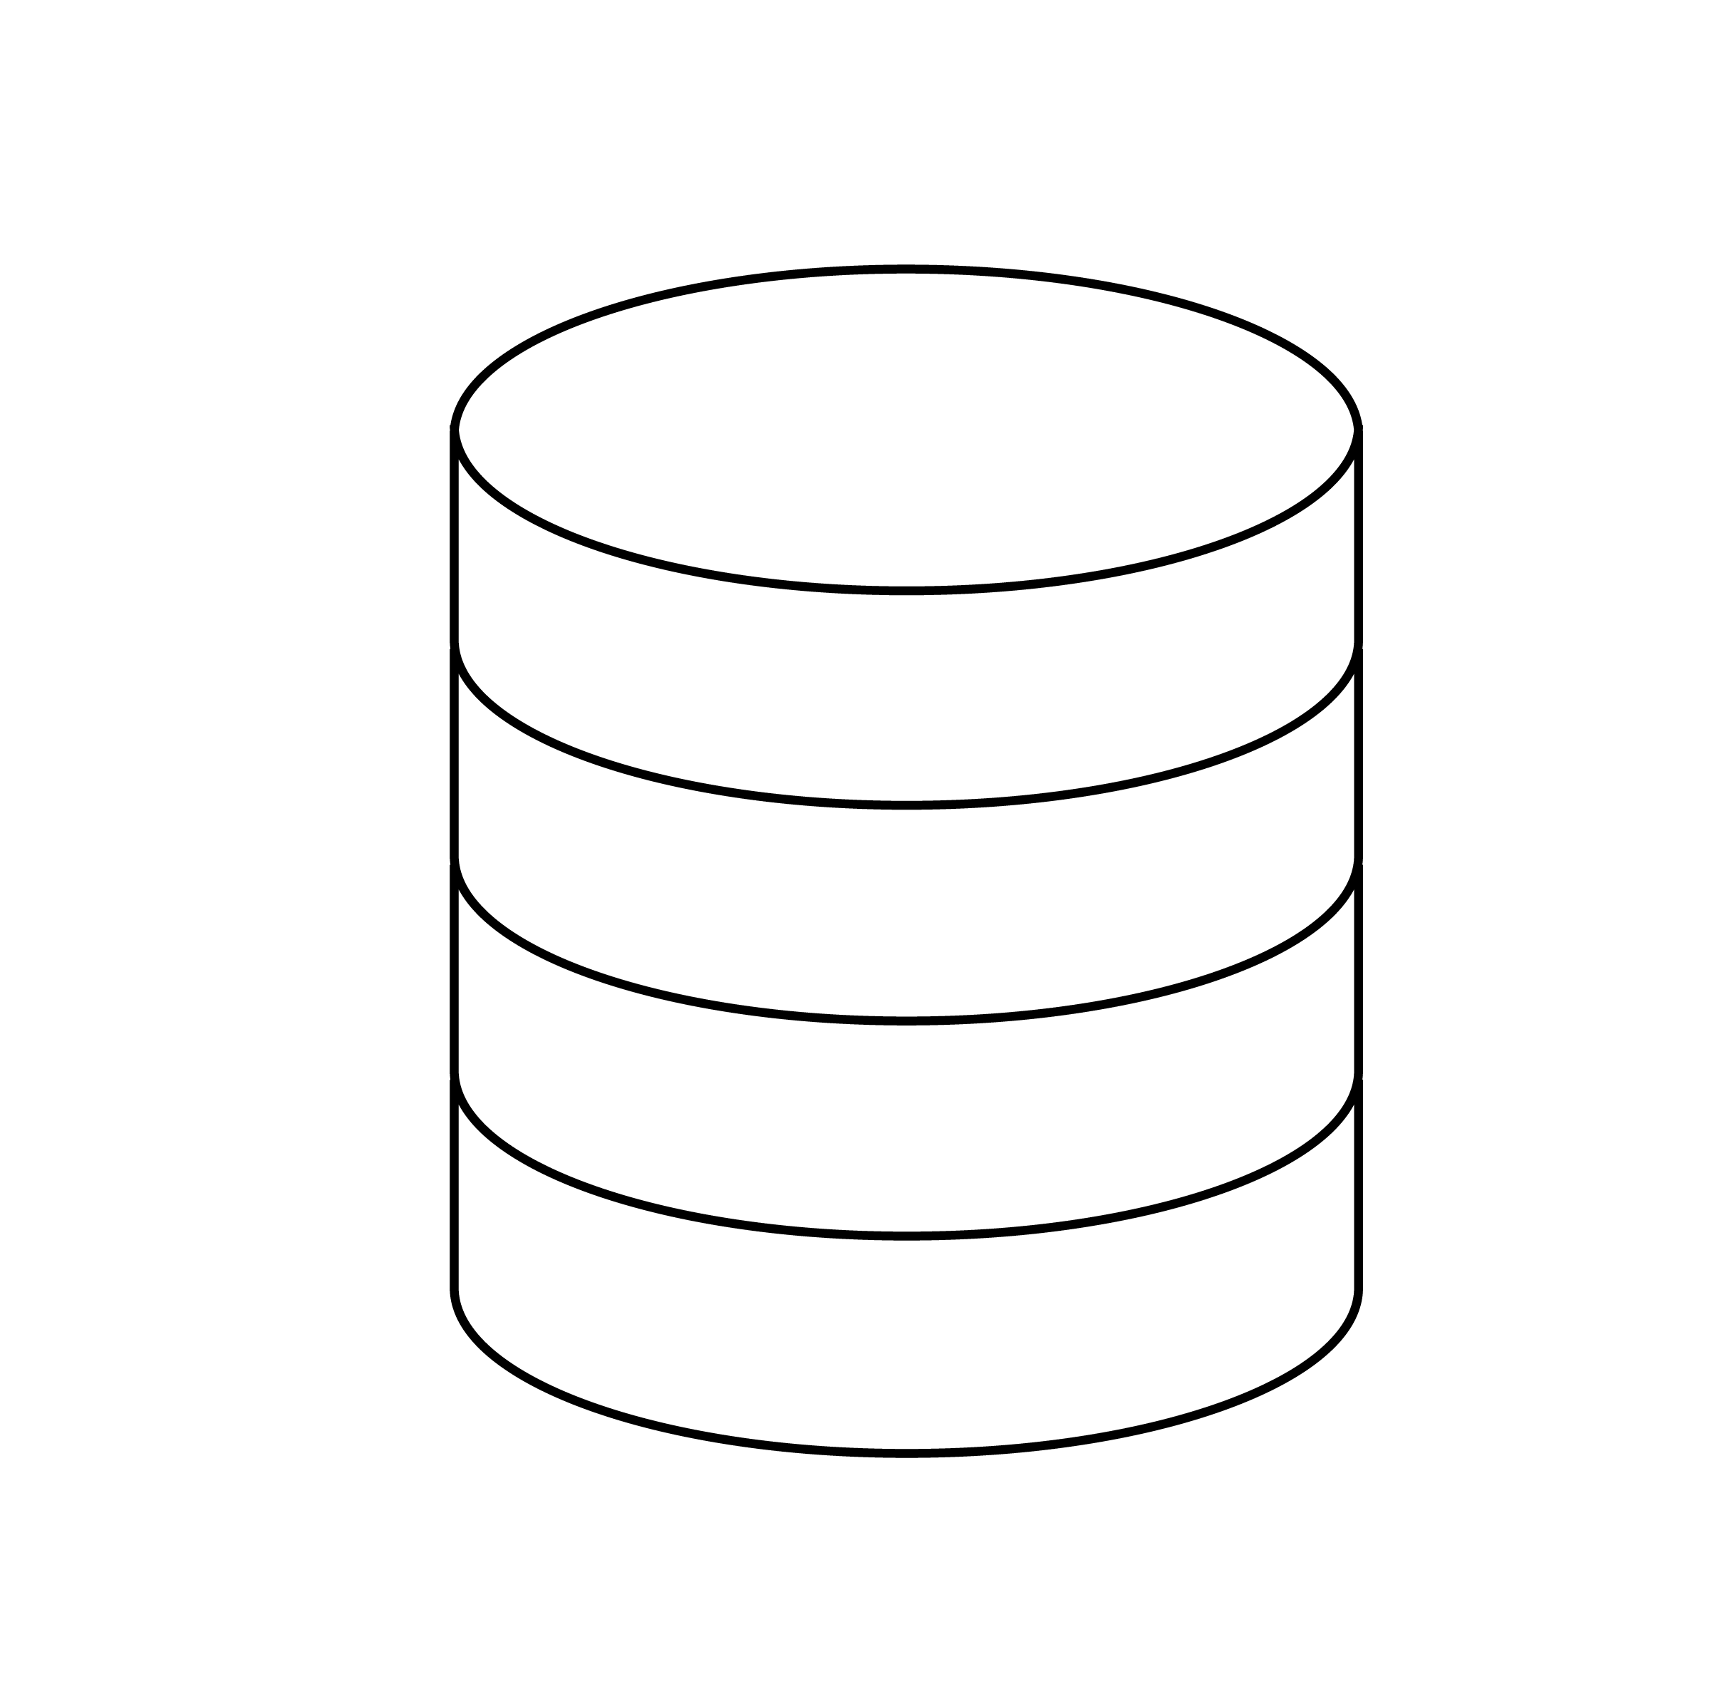
AI DEEP LEARNING INFERENCE WORKFLOW
A Process Implemented by Multiple Personas
Data Scientist | ML Engineer
ML Engineer
Optimization
Model Optimization
Trained
Models
Optimize For Multiple Constraints For High Perf. Inference
MLOps, DevOps
App Developer
Query
Inference Serving
AI Application
Result
Deployment
Model
Store
Scaled Multi-framework Inference Serving For High Perf. & Utilization On GPU/CPU
Notes:
Now that we’ve defined the backstage technicians, let’s define the actors, which in this case, are the different features that compose our end-user application. Data Scientists and Machine Learning engineers work to develop individual models, which then might be published to a model store. Backend Engineers and DevOps will then create a server that can access this model store. The application engineer can then access this server through various endpoints in order to build features requiring the models in the model store.
There are many other components that make up an application besides machine learning models such as accessing a data store to neatly arrange information for users or login systems. Application Developers and DevOps have the challenge of making sure any new features not only appear natural to users alongside older features, but also that they do not accidentally conflict with each other causing the application to go offline.

Slide 5



CHALLENGES IN MODEL DEPLOYMENT
Ease of Use
Cost of Deployment
Ecosystem Tools
Multiple Frameworks
Requires Retooling In Production
Different Types Of Optimizations:
Real Time, Batch, Streaming, Ensembles
Each Requires Serving Optimizations
Need For Mixed Infrastructure -
CPU & GPU on Cloud, Data Center & Edge
Disparate Serving Solutions Increase Cost
High Performance, Low Latency Inference on GPU and CPU
Hardware Underutilization Increases Cost
Scaled Deployment Needs Cluster Orchestration Tools
Lack of Integration w/ Standard Tools Drives Costly/Non-scalable Implementations
Notes:
Because of this, DevOps engineers and Application Developers consider a few factors before incorporating any new technology into their application.
First off, how easy is it to implement? Time is precious, and the easier a piece of technology is to setup, the more likely it will be easier to work with during production outages. Each ML Framework, such as TensforFlow, PyTorch, and ONNX have their own optimization strategies, making it potentially difficult to switch frameworks. Along with ease of use, is it cost efficient? A tool might be feasible and makes sense in the experimental phase where there are a handful of users, but costs can multiply quicky when it reaches thousands of new users. Another consideration, is how well the technology fits in with the other tools it will be integrated with. One could spend a lot of effort forcing two different frameworks to cooperate with each other, only to find all that hard work wasted with a library update.

Slide 6
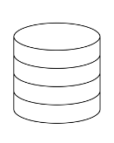




TRITON INFERENCE SERVER
Open-Source Software For Scalable, Simplified Inference Serving
Standard HTTP/gRPC
Or
C API
(directly integrate into client app)
Dynamic Batching
(Real time, Batch, Stream)
Multiple Client Applications
Per Model Scheduler Queues
Flexible Model Loading (All, Selective)
Multiple models
Query
Python/C++ Client Library
Multiple GPU & CPU Backends
Result
…
Model Repository
Custom
Python/C++
Metrics
Kubernetes, Prometheus
Utilization, Throughput, Latency Metrics
GPU
CPU
Monthly releases available on GitHub and on NGC as docker container
Notes:
To address all of these concerns, NVIDIA has developed the Triton Inference server. If you have an NVIDIA Tesla GPU such as a T4, V100, or A100, good news. Triton can be used to configure it with a set of http endpoints so users can communicate with your machine learning model over private and public networks. Triton was made with MLOps in mind with features such as model versioning, python or C++ backend apis, and metrics to track server usage.
https://docs.nvidia.com/deeplearning/frameworks/support-matrix/index.html

Slide 7

DESIGNED FOR DEVOPS/MLOPS
Triton Integrates Easily In Organization’s Workflow For All AI Use Cases
Kubernetes Integration
MLOps
Open Source & Customizable
Scalable Microservice In Kubernetes
Helm Chart For Fast Deployment
KFServing Integration
Live Model Updates | Dynamic Model Loading | Triton Model Analyzer
Integrated with Azure ML, Seldon, ClearML, and AWS SageMaker and Google CAIP as Custom Container
Completely Open Source – Inspect, Customize & Extend
Customizable Container –Modular Backends For Low Memory Footprint
Notes:
Some features include the ability to work with Kubernetes Autoscaler to scale the number of pods based on GPU or CPU utilization and is flexible enough to deploy new machine learning models without shutting the server down. It also has model versioning, allowing developers to deploy models on a live server, or to quickly remove a bad model version in case a rollback is needed. Additionally, it can be used with any major cloud provider such as Azure, AWS, or Google Cloud, and it is open source. Check out the Github repositories to provide feedback and track the latest updates.
KFServing is an emerging standard/platform for serverless inferencing
Support for Tensorflow and Caffe2 CPU optimizations using Intel MKL-DNN library
Allows frameworks backends to make use of multiple CPUs and cores Benefit from Triton features:
Multiple Model Framework Support
Dynamic batching
Custom backend
Model Ensembling
Audio Streaming API
4. Model loading: multiple ways – load all, load none but control via model control API

Slide 8









DEVELOPERS CAN FOCUS ON MODELS AND APPLICATIONS
Triton Takes Care of Plumbing To Deploy Models for Inference
Standardized Inference Platform
Inferencing on GPU and CPU
Different Types of Queries
Maximized Hardware Utilization
Custom
Backends
GPU
CPU
(Random Forest)
(For non-categorical features)
Real time
Batch
Stream
Ensemble
Support for All Major Framework Backends for Flexibility & Consistency
Standard HTTP, gRPC, and C++ Communication
Inference Serving on GPU, CPU, and Mixed Workloads
Cloud | Data Center | Edge
Bare Metal | Virtualization
Support for Different Types of Inference Queries and Use Cases
Concurrent Model Execution Increases Throughput & Utilization, lowering TCO
Dynamic Batching Maximizes Throughput Under Latency Constraint
Notes:
Developing server infrastructure can be time consuming, and admittedly, stressful when dealing with a live service. Triton will do the heavy lifting of optimizing computer hardware for various query types regardless if inference is done on the GPU or CPU.

Slide 9
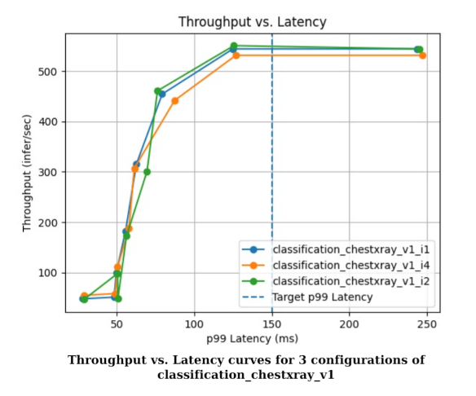
MODEL ANALYZER
Tool to automatically identify optimal model configurations to maximize performance
Specify constraints on performance results, latency and throughput
Model Analyzer automatically sweeps through different configurations (batch sizes, model instances, etc.)
Finds the best configuration for optimal performance under constraints
Analyze results through reports and charts
GitHub repo and docs: https://github.com/triton-inference-server/model_analyzer
Notes:
If you’d like to take hardware optimization further, Triton includes a model analyzer to find the best configuration for a model. For instance, on the right here, we can compare latency (how quickly the user gets a response for a query) versus throughput (how many queries can be processed within a certain time period). GPU memory can also be compared.
By specifying what our objective throughput, latency, or GPU utilization is, the model analyzer can identify optimal parameters for our model such as the best batch size or maximum queue delay.
Specify latency/memory/throughput constraint
Specify range of configurations to sweep through - batch size, number of model instances, etc.
Model analyzer automatically runs through each configuration and finds the optimal ones that maximizes performance under constraints
Generates performance charts to help visualize the throughput vs. latency vs. memory tradeoffs

Slide 10
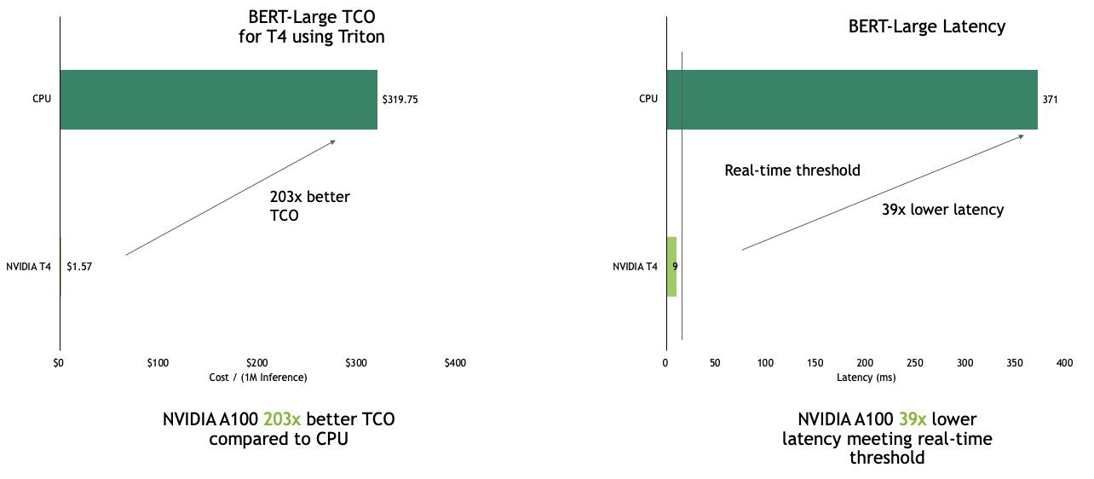
TRITON WITH NVIDIA T4 DELIVERS LEADERSHIP TCO AND LATENCY
CPU cost estimate with GCP C2-standard-64 instance. BERT Large Inference | Intel Xeon Platinum 8280: Precision = FP32 Triton Static Batching with PyTorch (BS=1, Concurrency=1). Seq Length = 384, Container 20.06
GPU cost estimate using Oracle BM.GPU4.8 . BERT Large Inference | NVIDIA T4 Precision = INT8 Triton Static Batching with TRT7.2 (BS=1, Concurrency=1) Seq Length = 384, Container 20.06
Notes:
The larger the model and the more users, the higher the benefit of using GPUs for machine learning inference. In the above graphs, we’ve compared the cost and latency of a production machine learning BERT model using PyTorch. The cost is averaged over millions of queries and is based on the price to rent the respective hardware on the cloud. Not only do GPUs provide hundreds of times better Total Cost Ownership, but they’re also significantly faster at processing requests. This is critical for industries like online retail where a fraction of a second could be the difference between a user purchasing a product or not.

Slide 11
OTHER FEATURES
Notes:
There are a few other helpful features of Triton we’d like to note.

Slide 12
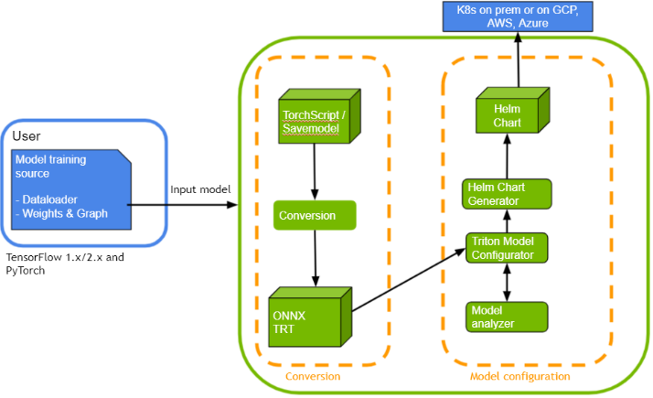
MODEL NAVIGATOR
A new tool which automatically prepares a trained model for instance deployment on Triton
Automatically converts TF SavedModel and PyTorch Torchscript models to TensorRT Plan
Validates accuracy after TensorRT conversion
Uses Model Analyzer underneath the hood to find best configuration
Automatically generates helm chart to deploy on Kubernetes
https://github.com/triton-inference-server/model_navigator​
Notes:
Triton’s Model Navigator has a number of tools useful for deployment. For instance, it can convert a PyTorch TorchScript model into an ONNX model and visa versa. It can also automate the model analyzer to compare multiple configurations for a model and selects the best one. It can also generate a Helm Chart to deploy a model with a cloud provider that supports Kubernetes.
Specify latency/memory/throughput constraint
Specify range of configurations to sweep through - batch size, number of model instances, etc.
Model analyzer automatically runs through each configuration and finds the optimal ones that maximizes performance under constraints
Generates performance charts to help visualize the throughput vs. latency vs. memory tradeoffs

Slide 13
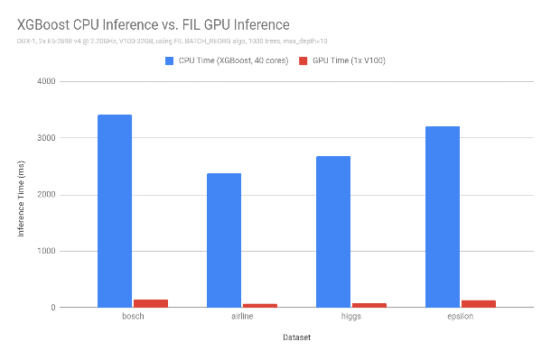
TRITON: RAPIDS FOREST INFERENCE LIBRARY (FIL)​
Inference on Tree-Based ML Models
RAPIDS FIL is a library (part of cuML) designed to provide high-performance inference for tree-based models. ​
Trained XGBoost, LightGBM, cuML RandomForest, and SKLearn models imported into FIL through treelite
No conversion needed for XGBoost and LightGBM. SKLearn or cuML pickle models converted to Treelite's binary checkpoint format
XGBoost is supported
LightGBM is supported for non-categorical features
SKLearn Random Forest is supported for single-output regression and binary classification
CPU support in next Triton 21.07 release
23x
34x
23x
36x
Single V100 32G GPU can infer up to 34x faster than XGBoost dual-CPU node
Documentation: https://github.com/triton-inference-server/fil_backend
Notes:
Triton isn’t just for neural networks. It also supports the Rapids Forest Inference Library (FIL) in order to productionize XGBoost, LightGBM and RandomForest models.
Conversion scripts provided in FIL backend
DGX-1, 2x E5-2698 v4 @ 2.20GHz, V100-32GB, using FIL BATCH_REORG algo, 1000 trees, max_depth=10
Trained in XGBoost using data from https://github.com/NVIDIA/gbm-bench
Release 0.9

Slide 14



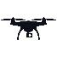
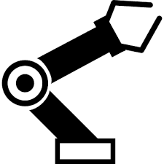
TRITON IN EMBEDDED DEVICES
Triton is supported on all Jetson platforms: Xavier, Nano, and TX2
Supported Features:
TensorFlow 2.4, TensorFlow 1.15.5, TensorRT 7.1, ONNX RT 1.8, and Custom backends
Model Ensembling
GPU support
Shared Library and C API
C++ and Python client libraries and examples
Triton Jetson release available as tar file on Triton GitHub:
https://github.com/triton-inference-server/server/releases
Edge Devices
Triton can also be integrated as a shared library (via C-API) in embedded devices with full feature support.
Supports both CPU and GPU
Notes:
This day in age, computers take on many shapes and sizes. Triton is available on all Jetson platforms, NVIDA’s AI on the edge devices.

Slide 15
HANDS-ON LAB
Notes:
Now it’s time to put the theory to practice. In the hands-on lab, we’ll be interacting with an up and running Triton server.

Slide 16
NOTEBOOKS
1: Getting Started
2: Simple PyTorch Model
3: HuggingFace Model
4: Simple TensorFlow Model
5: Simple TensorRT Model
6: Advanced Inference
Triton on Docker
Creating configuration files
A more complicated example
Model Conversion from ONNX to TensorRT
Model Analysis
Framework differences
7: Metrics
Setting up a metrics server
Notes:
The lab is divided into 7 Jupyter Notebooks.
First, we’ll look at how Triton is deployed using Docker. Second, we’ll see how to deploy a simple Pytorch Model to production using configuration files.
In the third notebook, we’ll deploy the significantly more complicated HuggingFace Model. Then, in the fourth notebook, we’ll observe framework differences as we deploy a TensorFlow Model. Don’t worry if you’re not familiar with all the machine learning frameworks. Today, we’re more concerned with taking an already trained model and deploying it. However, if you do have a framework preference, we’ll show how to convert one model to another framework in the fifth notebook. There, we will learn how to convert from ONNX to TensorRT.
In the sixth notebook, we’ll look at how to optimize deployed models with the Model Analyzer and other tools, and finally, we will look at the metrics automatically provided by Triton.

Slide 17


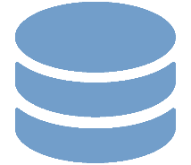

TRITON: BRINGING THE 3 TEAMS TOGETHER
Inference Serving: Simplified, Highly Performant & Flexible
Trained Models
Apps with trained Models
Data scientists
Developers, ML Engineers
DevOps, MLOps, IT Operators
Retraining
Any framework
Any repository
Any platform
TensorFlow | TensorRT Plan | PyTorch | ONNX RT | OpenVINO | Custom
Local storage | AWS S3 | Google Compute Storage | Azure Storage
Cloud (AWS, GCP, Azure) | Data center | Edge | GPU | CPU
Download & Get started: https://developer.nvidia.com/nvidia-triton-inference-server
* Via Kubernetes volume
Notes:
We’re about to enter the hands-on portion of the lab, but before we part ways, just a couple more closing thoughts. The easier it is to understand a technology, the more reliable it will be. That’s why Triton is open source and viewable on GitHub. There is also a ready to go Docker container on NVIDIA GPU Cloud, or NGC. If you’re curious to see how other companies have used Triton, we have a list of Case Studies in the slide notes for this class.

Slide 18
Notes:
Ready to put on a show? Time to get coding. Good luck!

Slide 19
OPEN SOURCE EXAMPLES OF TRITON
Application | Model | Framework | GitHub URL for example with Triton
Computer Vision | ResNet50 | PyTorch, TensorRT | https://github.com/NVIDIA/DeepLearningExamples/tree/master/PyTorch/Classification/ConvNets/triton/resnet50
 | ResNeXt-101 | PyTorch, TensorRT | https://github.com/NVIDIA/DeepLearningExamples/tree/master/PyTorch/Classification/ConvNets/triton/resnext101-32x4d
 | SE-ResNeXt-101 | PyTorch, TensorRT | https://github.com/NVIDIA/DeepLearningExamples/tree/master/PyTorch/Classification/ConvNets/triton/se-resnext101-32x4d
Natural language Processing | BERT | PyTorch | https://github.com/NVIDIA/DeepLearningExamples/tree/master/PyTorch/LanguageModeling/BERT
 | BERT | PyTorch, TensorRT | https://github.com/NVIDIA/DeepLearningExamples/tree/master/TensorFlow/LanguageModeling/BERT/triton
Automatic Speech Recognition | Jasper | PyTorch, TensorRT | https://github.com/NVIDIA/DeepLearningExamples/tree/master/PyTorch/SpeechRecognition/Jasper/triton
Text to Speech | Tacotron2 & WaveGlow | PyTorch, TensorRT | https://github.com/NVIDIA/DeepLearningExamples/tree/master/PyTorch/SpeechSynthesis/Tacotron2/trtis_cpp
Recommendation Systems | DLRM | PyTorch, TensorRT | https://github.com/NVIDIA/DeepLearningExamples/tree/master/PyTorch/Recommendation/DLRM/triton
Notes:
Add to next steps

Slide 20
CASE STUDIES

Slide 21





TRITON CUSTOMER CASE STUDIES SUMMARY
Company | Triton Use Case | Workflows | Outcome
 | Computer vision, facial recognition, and biometric applications | Integrated their highly performant TNN framework into Triton as a custom backend | Standardized high performance inferencing for all AI applications across their entire organization
 | Real time grammar checker running more than half a trillion queries a year | NLP models (BERT, Turing-NLG, etc) | Slashed costs by ~70% and achieved a throughput of 450 queries per second on a single V100 GPU, with less than 200 ms response time
 | Any ML use case | Real-time inference serving on Triton with Azure ML and ONNX Runtime | Increased throughput by ~7x compared to Flask (general purpose end-to-end python server)
 | Identifying trends in 300B pins for better search results | High throughput batch inference - deploying CV models on Triton on V100 | Achieved 3x greater throughput with Triton dynamic batching
 | Fraud detection on 8B credit card transactions | Used Triton to deploy a TensorRT Gated Recurrent Unit model to analyze tens of millions of daily transactions | Achieved 2 ms latency budget (a 50x improvement compared to CPUs that could not meet the latency requirement)
 | Hazardous package detection, damage classification, stamp detection and more | Deploying CV deep learning models on Triton at the edge | Triton used as a single standardized inference platform across 192 Distribution Centers, analyzing 7 Billion Packages Per Year
 | Defect detection on 30,000 wafer images per day | Used Triton to deploy and manage DenseNet, Autoencoder, and UNET models in TensorRT | Can detect 100% of defects with <10% false positives (7x improvement), and scale to 100 different models without changes to serving infrastructure
 | Search recommendations and image classification | Models in multiple frameworks (TensorFlow, PyTorch, Caffe, and TensorRT) on CPU and GPU | A single inference platform that allowed for faster rollout of new DL models from multiple frameworks and lowered Naver’s operational costs
 | High Energy Particle Physics | Deploying Graph Neural Networks using Triton on T4 GPU | Obtained a 17x speedup in performance

Slide 22
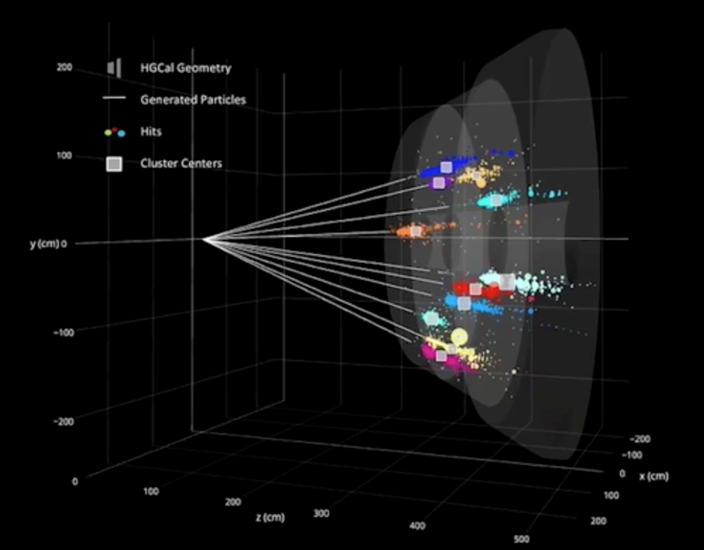

FERMILAB USES TRITON TO SCALE DEEP LEARNING INFERENCE IN HIGH ENERGY PARTICLE PHYSICS
Offline Neutrino Reconstruction
400TB Data from Hundreds of Millions of Neutrino Events
17x Speedup of DL Model on T4 GPU Vs. CPU
Triton in Kubernetes Enables “DL Inference” as a Service
Expected to Scale to Thousands of Particle Physics Client Nodes
Client
Detector data
Triton
Cluster Assignments
Over Network
Neutrino Event Classification from Reconstruction
T4 GPU
Notes:
Context:
1.Full offline reconstruction of neutrino events to study interactions, uses a multiple stage workflow
2.Last stage uses ML to classify wire hits as being track-like, shower-like, or Michel electron-like
3.The workflow processes 400 TB of images from hundreds of millions of neutrino events
Problem:
1.The last stage ML is very compute intensive. 65% of the total time is spent in this stage on a CPU.
2.How to speed up this process?
3.How to scale this to handle thousands of client nodes feeding detector data
Solution
1.Use T4 GPUs and Triton in a “inference as a service” deployment
2.Cluster of GPUs with Triton running on each server. Clients run on CPUs send inference requests over the network.
3.Kubernetes used to orchestrate the cluster – load balancing and scaling of Triton
Impact
1.17x speed up on T4 vs CPU of the ML stage.
2.Overall workflow speed up - 2.7x
3.With Triton, Client applications don’t need any modifications. They are decoupled from Model frameworks, input batching, multi-GPU servers. Triton takes care of all of them. Models can be updated independently, and diverse GPUs can be used.
4.GPU utilization is maximized. Large number of client applications running on remote CPU only servers can access the GPUs for inference via Triton to speed up the reconstruction workflow.

Slide 23
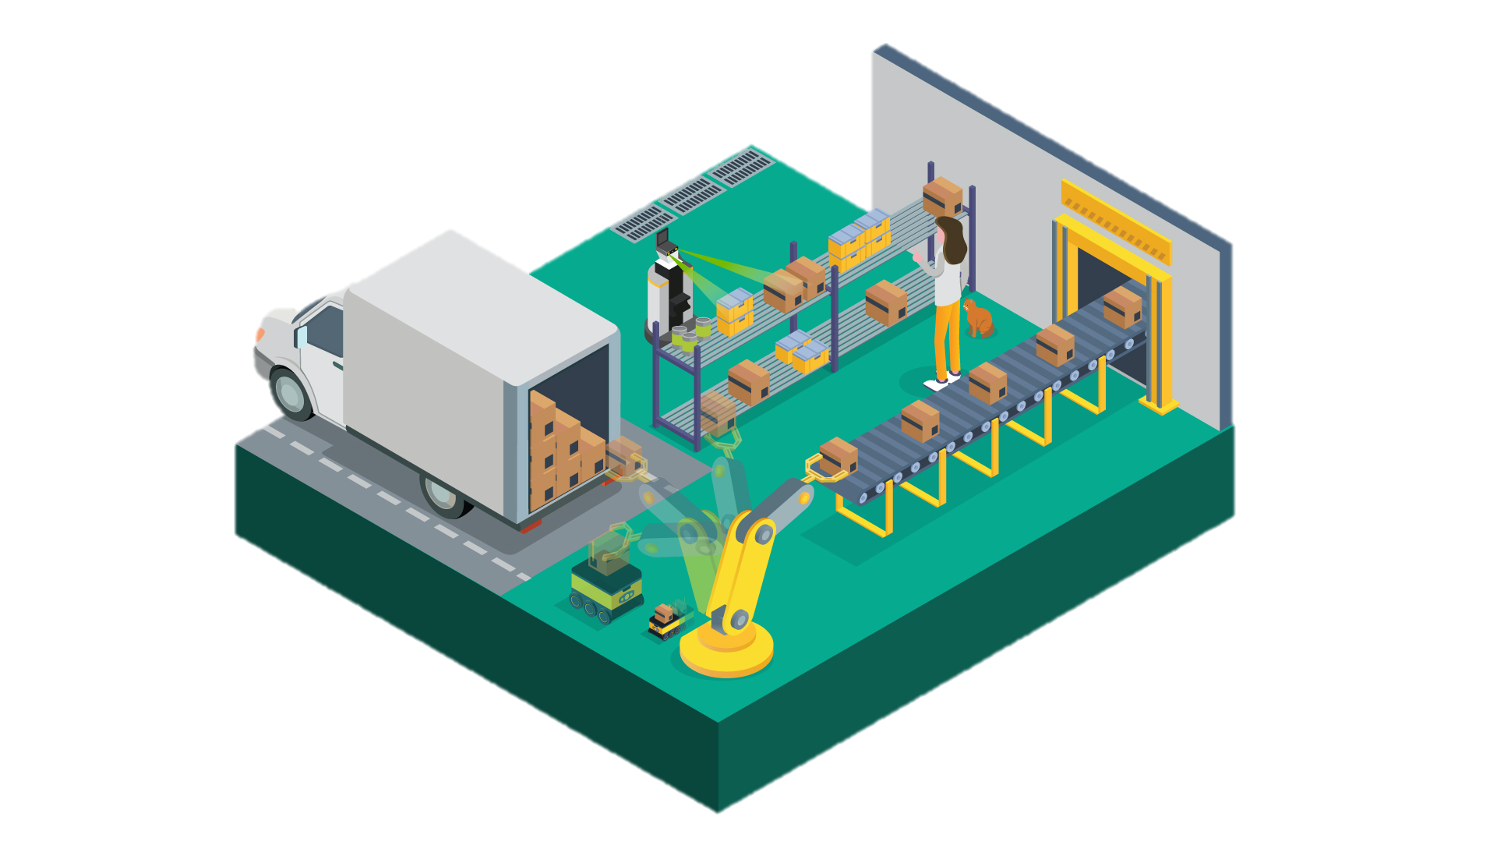

ANNOUNCING USPS ADOPTS TRITON FOR PACKAGE ANALYTICS
Bringing Rapid, Accurate & Safer Package Delivery
Triton Enabled Microservices Infrastructure For Edge AI
For Hazardous Package Detection, Damage Classification, Stamp Detection And More
192 Distribution Centers | 7 Billion Packages Per Year

Slide 24

PINTEREST
Pinterest Uses Triton to identify trends in 300B pins for better search results
Provide a delightful customer experience through highly relevant search results and recommendations to 259M monthly active users worldwide
State of the art computer vision models by Triton on V100 process 300B pins(images) every night to extract embedded features
High throughput batch inference - 3x higher throughput with Triton dynamic batching

Slide 25


THE NEW AI ERA FOR RETAILERS
In order to make in-store retail experiences as streamlined as online shopping, Tracxpoint, a global provider of next-generation self-checkout grocery solutions, created the Artificial Intelligence cart (AiC).
With AiC, shoppers simply place products in their carts and then receive personalized product offers in real-time, navigate the supermarket with ease, and pay digitally.
Tracxpoint uses the NVIDIA DGX Station to train models 5x faster than a CPU server. NVIDIA DeepStream SDK on Jetson TX2 delivers real-time video analytics. TensorFlow and TensorRT optimized models run on NVIDIA T4 Tensor Core GPUs, allowing AiC to recognize 100,000 products in under a second.
NVIDIA Triton Inference Server is used to deploy the models from TensorFlow and TensorRT for real-time inferencing. Models are retrained daily and Tracxpoint updates those seamlessly in Triton Inference Server with no disruptions to users.
Notes:
Tracxpoint LLC
Industry: Retail
Data: RGB-Images, 1000 x / Product
NVIDIA Products: DGX station for training, T4, Jetson TX2, TensorRT, Deepstream SDK 2.0, Triton inference server, TensorFlow, Keras
Customer Contact(s): Edi Bahous/ co-founder & CTO | NVIDIA contact: Nati Amsterdam
Summary
In store retail experience is not as easy or as streamlined as the online retail experience. Tracxpoint created a shopping cart that’s fully integrated with hardware and AI powered, GPU-accelerated software, called AIC. Trained on DGX Station and inferenced using TensorRT and Deepstream 2.0 on Jetson TX2, AIC can recognize 100,000 individual products in under a second with a high accuracy.
NVIDIA Triton inference server is used to deploy and serve multiple models from different frameworks for real-time inferencing. Models are retrained daily and Tracxpoint updates those seamlessly in TensorRT inference server.
Customers can now simply take products, toss them in the cart (no need to search for barcodes), and immediately begin receiving personalized offers during their shopping. They can navigate inside the supermarket with ease and at the end pay digitally on cart.
Comparing to Quadro p6000 GPU card, the previous solution Tracxpoint used, they see 3x performance increased and more stability with the DGX Station. Running their DGX Station 24/7 for training, the return on investment compared to the AWS cloud is within 2 months.
Problem
No online shopping experience in the physical stores. Shoppers must wait in line.
Solution
Shopping cart with new design, integrated hardware and AI – the AI Cart or AiC.
Before they were using Quadro p6000 GPU card. Using DGX Station, the performance increased in x3 times and more stability
Result(s)
Deep learning based new shopping cart system can recognize the product visually with a high accuracy and can recognize one hundred thousand individual products in under a second on NVIDIA GPUs.
With DGX Station, Tracxpoint is able to continuously train multiple models on thousands of daily updated products, 5x faster than on standard CPU server.
NVIDIA DeepStream allows them to process 100’s of simultaneous video streams from multiple cameras on the cart at 100 fps. It is successfully able to detect multiple items placed in the cart under different lighting conditions.
TensorRT optimized models running on T4’s enables Tracxpoint to meet the target rate of 100,000 inferences/s to recognize 100,000 products per second.
Triton Inference Server is used to deploy and serve multiple models from different frameworks such as TensorFlow and TensorRT for real time inferencing. Models are retrained on a daily basis. Tracxpoint is able to update the models with new versions in Triton Inference Server seamlessly without any application restarts and disruptions to the end users.
Impact
Using AiC, customers of supermarkets can easily take products, toss them in the cart (no need to search for barcodes), communicate in real-time with suppliers and get personalized offers during their shopping, navigate inside the supermarket and at the end pay digitally on cart. No need to scan the products again.
About the Customer
Tracxpoint is building the new Retail AI-Pipeline that guarantees an individual shopping experience with cashier-less on-card payment.
Their system includes a unique combination of AI-Engines, IoT- & proprietary sensor fusion.
More Information
http://www.tracxpoint.com

Slide 26
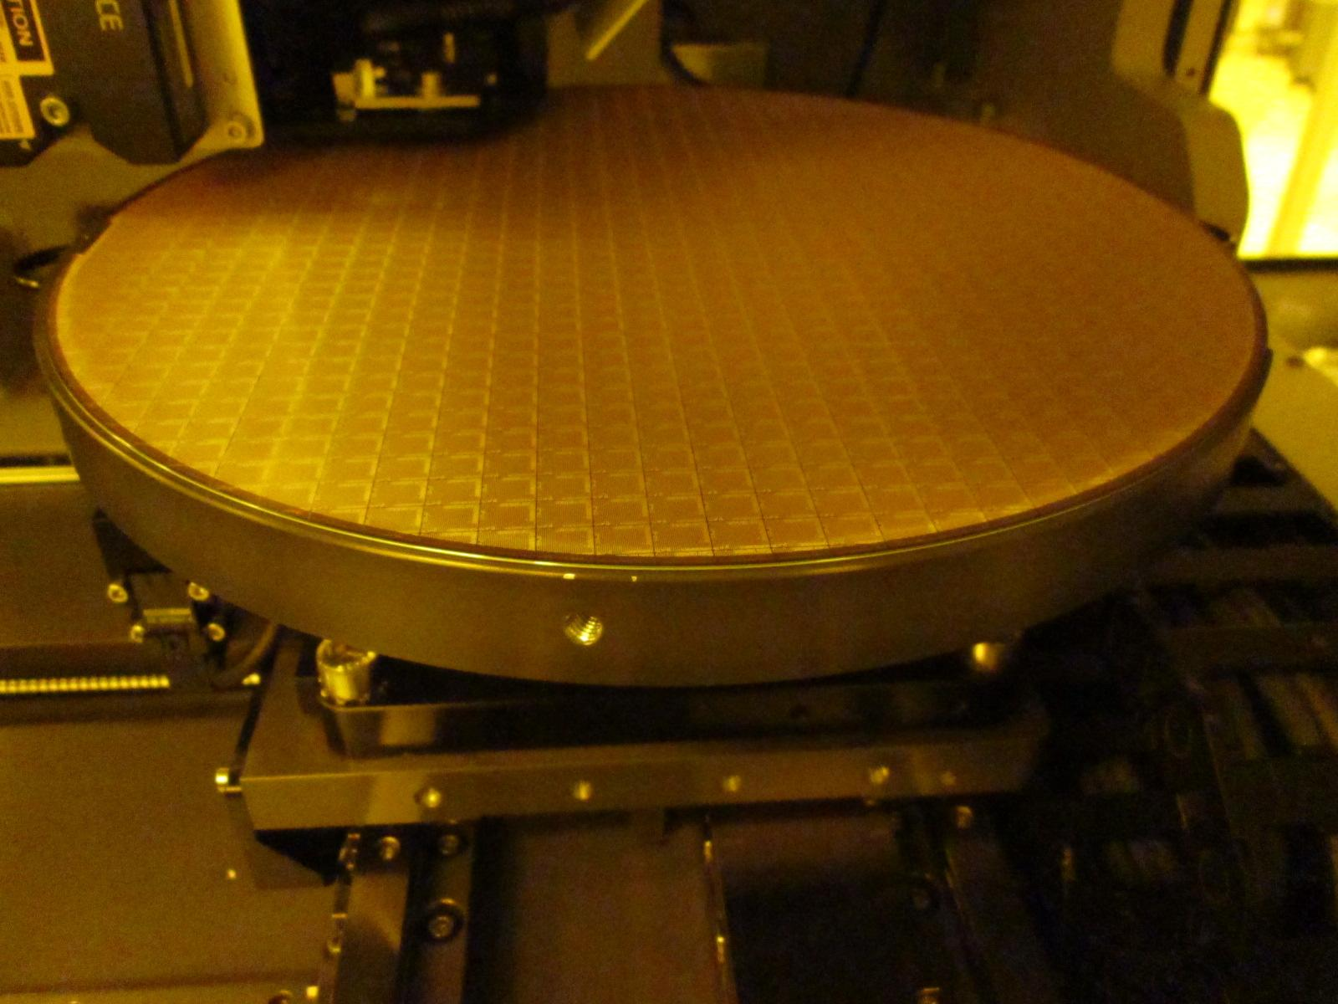


KEEPING AN ‘AI’ ON
WAFER QUALITY
Defective wafers have costly consequences to downstream production. SPIL uses AOI to detect defects, but its AOI platform produces up to 70% false positives ― which
then require a 2nd inspection.
To improve effectiveness SPIL implemented an AI-based 2nd level inspection system powered by NVIDIA DGX-2
for training and NVIDIA T4 with TensorRT for inferencing. NVIDIA Triton Inference Server
is used to manage multiple models.
SPIL now detects 100% of defects with <10%
false positives ―a 7X improvement— and
easily scales production line models
from 10 to 100.
Notes:
Silicon Precision Industries (SPIL) – Automated Defect Screening
Industry: Semiconductor Manufacturing
Data: Images
Products: NVIDIA DGX-2 for training, NVIDIA Tesla T4 GPUs, NVIDIA TensorRT, NVIDIA Triton Inference Server, Frameworks: U-Net, Densenet and Autoencoder
NVIDIA Contact: Andrew Liu
Customer Contact: Katch Wan, TD Director (presented at AI summit June 2019)
Summary
A defective wafer has costly implications to downstream production processes.
SPIL, the largest outsourced semiconductor assembly and test company in the world², inspects ~30,000 wafer images per day per production line as part of its wafer bumping service. They use an auto-optical inspection (AOI) platform that produces 70% false positives – which then require a second screening.
To improve production effectiveness SPIL implemented a deep learning-based 2nd level wafer inspection system. Powered by the NVIDIA DGX-2 with V100 for model training, Tesla T4 GPUs for production, TensorRT and Triton Inference Server, the deep learning system detects 100% of defects with <10% false positives resulting in massive productivity gains.
One deep learning model per product is used in the production line. Triton Inference Server to dynamically loads and unloads models. SPIL is planning to scale the number of models from 10 to 100 products.
Context
A defective wafer has costly implications to downstream production processes.
On a single production line ~30,000 wafer images need to be inspected per day (6 Auto-Optical Inspection (AOI) machines * 10 lots * 500 images per lot)
In this case, the production line referenced is used in the wafer bumping process
Before: AOI with ~70% false positive + human second screening (to remove false positives)
After: AOI with ~70% false positive + DL second screening. DL system detects 100% of defects with <10% false positives.
Problem
Before: 70% false positives from AOI machines were being inspected manually – costly and time consuming
Solution
NVIDIA DGX-2 for training
NVIDIA Tesla T4 GPUs, NVIDIA TensorRT, NVIDIA Triton Inference Server for production
Frameworks: U-Net, Densenet and Autoencoder
Result(s)
The DL second screening method detect 100% of defects with less than 10% false positives
Impact
Improved efficiencies
Reduced false positives, reduced manual inspections across all SPIL production lines (once implemented across all lines) will mean massive productivity gains
SPIL plans to increase the number of images/day that it inspects as it scales the number of models from 10 to 100 products.
About the Customer
The largest outsourced semiconductor assembly and test company in the world.
More Information
https://www.spil.com.tw/
² https://www.spil.com.tw/about/?u=1
“According to the market research firm Gartner, ASE is the largest Outsourced Semiconductor Assembly and Test (OSAT) provider, with 19% market share.^{[8]} The company offers services such as semiconductor assembly, packaging and testing.” https://en.wikipedia.org/wiki/ASE_Group and http://semiengineering.com/foundries-vs-osats/
³ https://www.spil.com.tw/about/?u=4

Slide 27
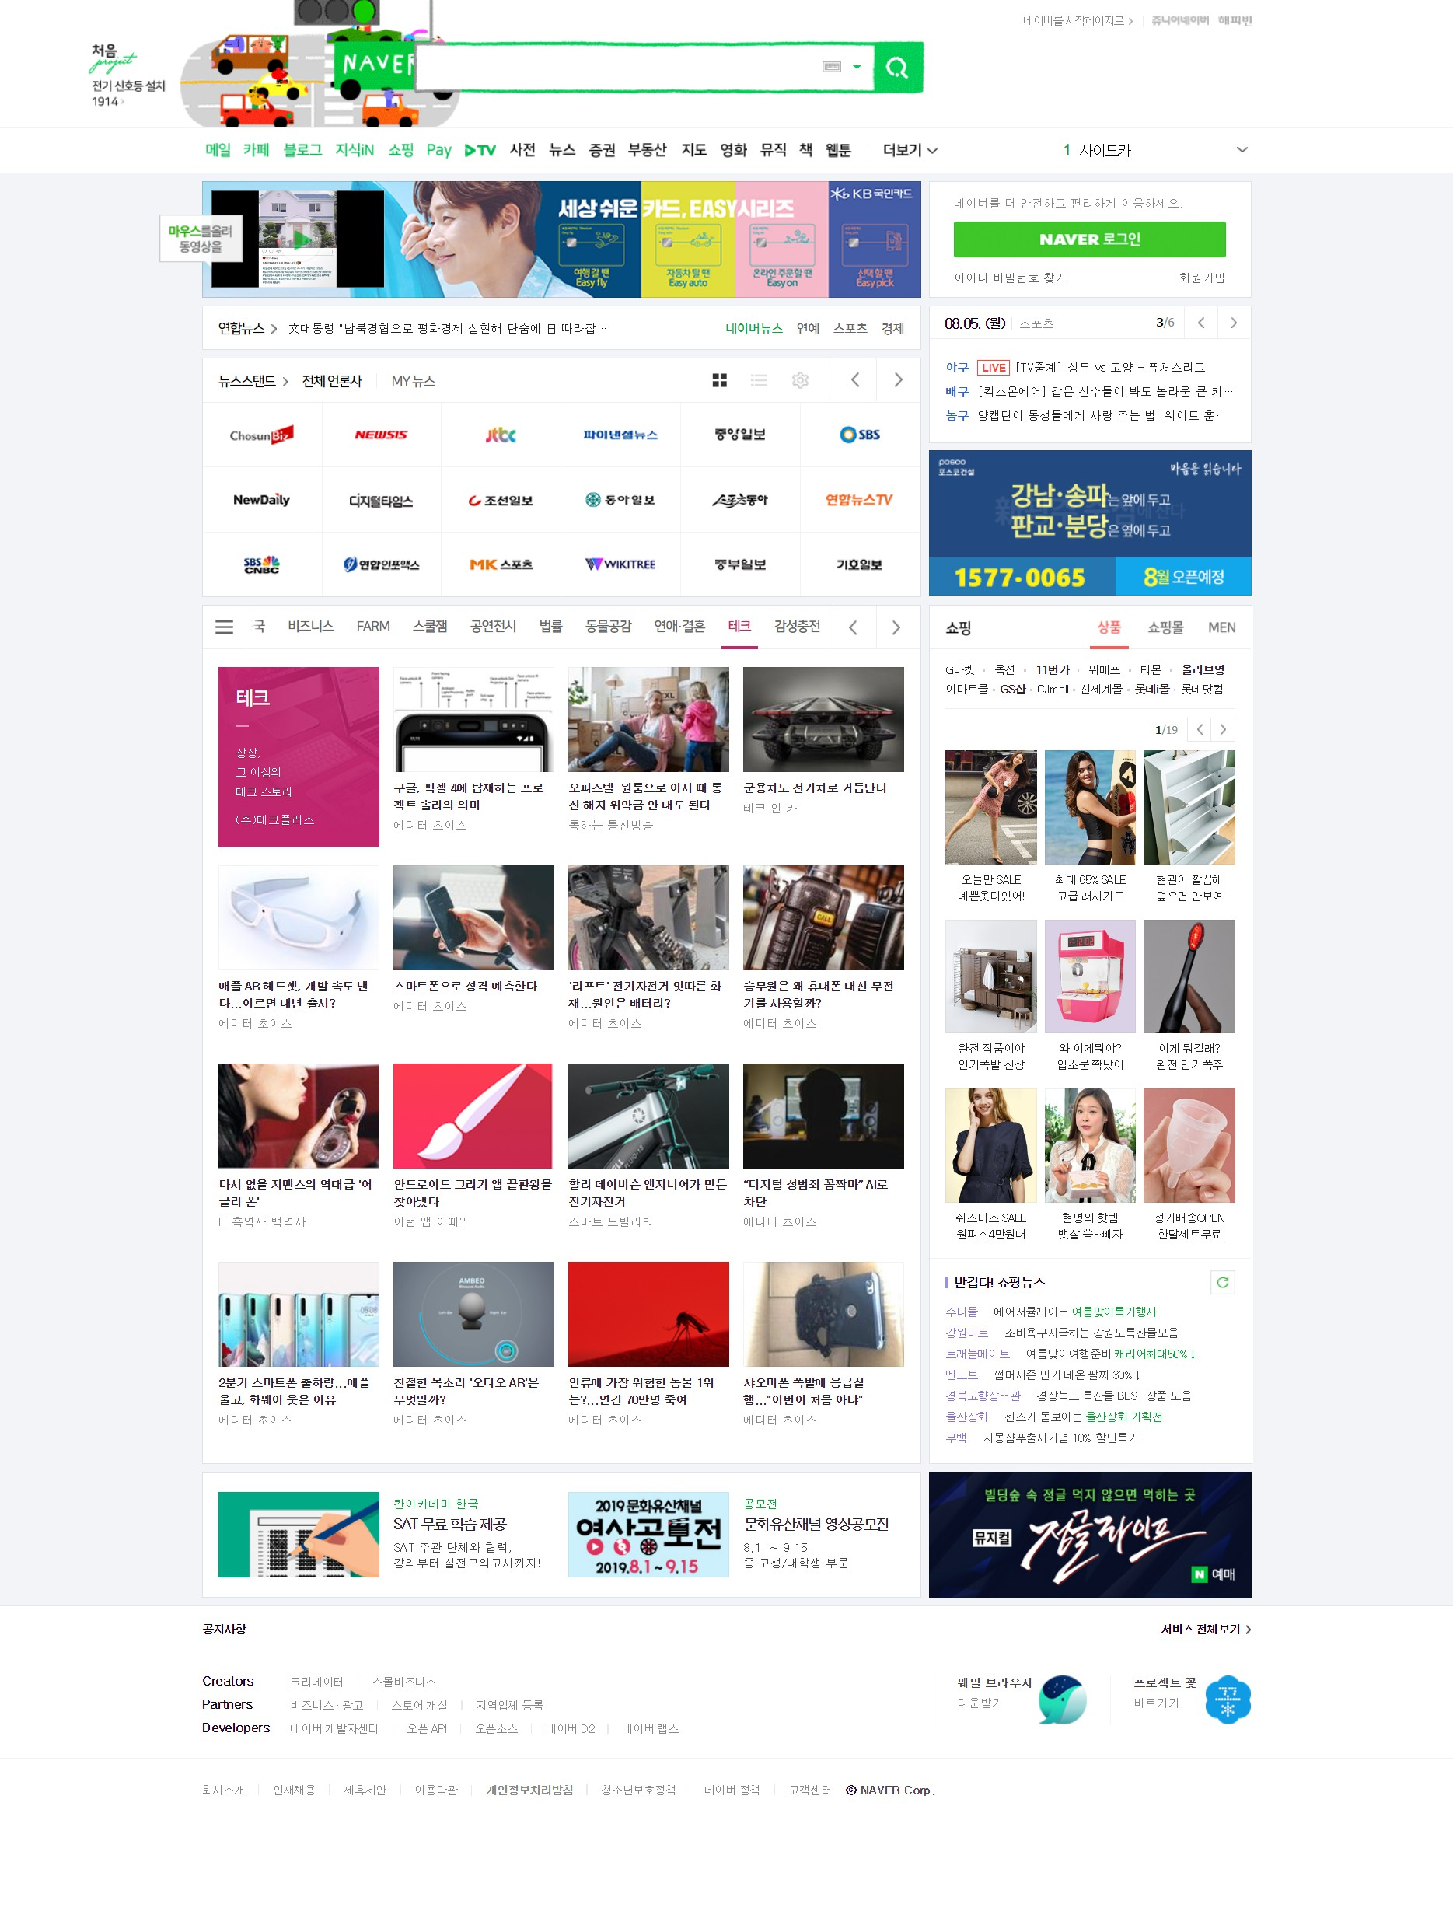
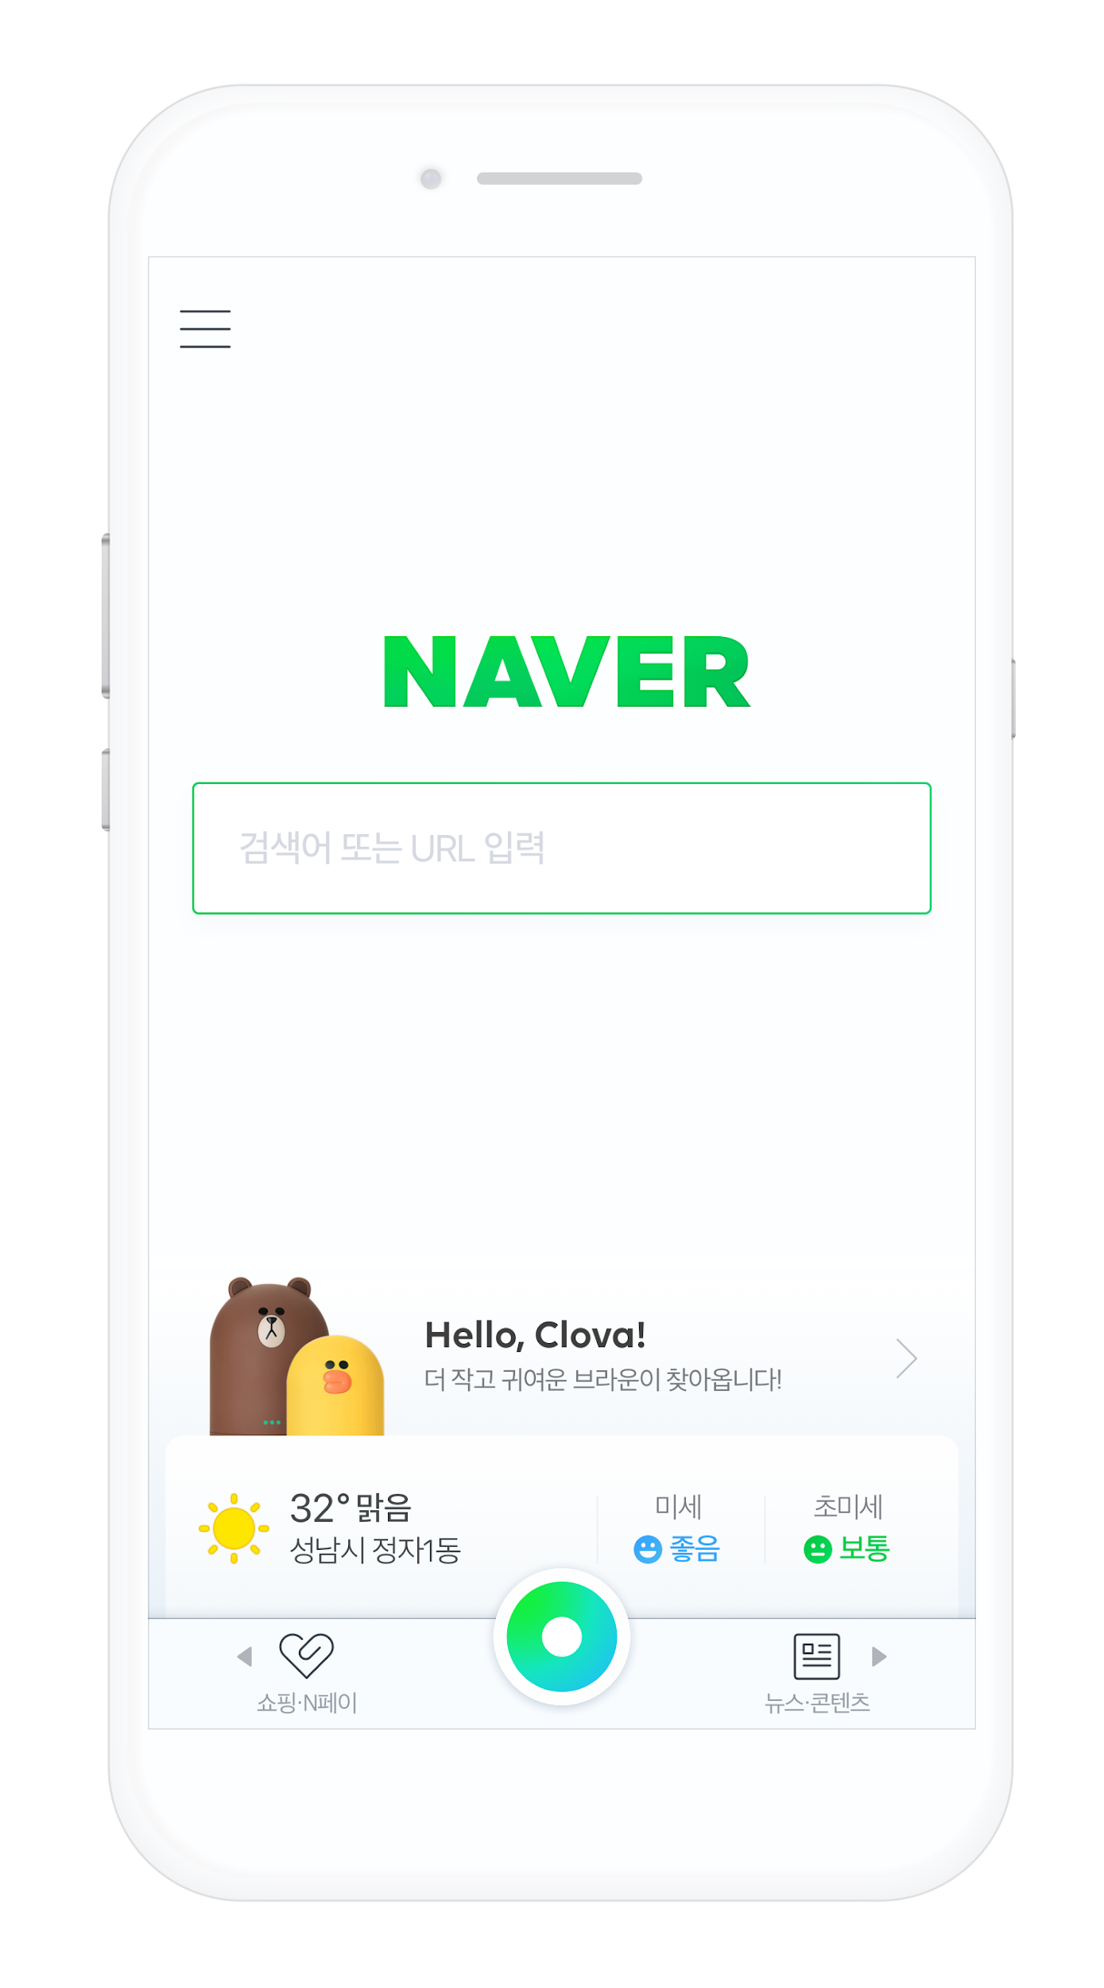

UNIVERSAL
INFERENCE ENGINE
Naver is the #1 search engine and internet services company in South Korea. They use deep learning, built with multiple frameworks, to enrich and diversify query results.
Naver uses Triton Inference Server to accelerate the deployment of models in production. The platform
supports multiple frameworks, batch and real-time inferencing, and inferencing on GPUs and CPUs.
It helps Naver roll out new AI-based
services faster and with lower
development costs.
Notes:
Naver - Standardized inference platform built on NVIDIA Triton Inference Server services multiple frameworks without impacting real-time internet services
Industry: Consumer Internet Services
Data: N/A
Products: TensorRT, Triton Inference Server
NVIDIA Contacts: Soyoung Jeong, Tripti Singhal, Shankar Chandrasekaran
Summary
Naver, the #1 search engine & internet company in South Korea, provides internet search and online content services to a country with >95% internet penetration. Foundational to its success are high quality (i.e. ‘fast’ & ‘accurate’) search results. Multiple deep learning frameworks are used for real-time image classification, search recommendations and others. Use of Multiple frameworks impacted the timely introduction of new AI models and the ability to manage them cost efficiently.
Managing multiple, siloed deep learning frameworks (TensorFlow, PyTorch, Caffe and TensorRT) in use by developers impacted the ability of Naver’s data scientists to roll out new models quickly. They also needed to support real time, batch & streaming inference.
Naver accelerates its use of DL models across the organization with a foundational inference platform built on NVIDIA Triton Inference Server to manage diverse frameworks, diverse types of inference, diverse types of hardware (GPU and CPU).
Having a single inference platform lowers Naver’s management costs and allows for faster rollout of new deep learning models.
Context
Naver is the #1 Internet Company in Korea with 70% of the market. (https://www.theegg.com/seo/korea/naver-seo-guide-understanding-the-korean-search-engine/)
Korea is one of the most wired country with more than 95% Internet penetration rate (http://www.koreaherald.com/view.php?ud=20180624000197).
And more than 90% of Korean Internet users use Naver as their search engine (http://www.businesskorea.co.kr/news/articleView.html?idxno=30000) .
Naver’s major revenue comes from search advertisement. It continuously looks to serve its customers with better results – high quality search results, better search keyword recommendations, etc.
Several teams in Naver develop deep learning models. They have a common platform called C3DL.
Naver provides Internet search and online content services in South Korea. They use Deep learning for image classification and search keyword recommendation in their services
Referred to as ‘the Google of South Korea’
Problem
Manage multiple deep learning frameworks (TensorFlow, PyTorch, Caffe and TensorRT) in use by developers.
Ability to support real time, batch & streaming inference.
Solution
Integrate NVIDIA Triton Inference Server into the DL & Search platform.
Result(s)
Maximizes GPU utilization, developers can devote their time to improve & create new models from any framework without worrying about inference
Impact
Helps establish a standard inference platform for both GPU and CPU, different types of inference.
Customer Quote (optional)
About the Customer
Naver provides Internet search and online content services in South Korea. They use Deep learning for image classification and search keyword recommendation in their services.
Naver is the #1 Internet Company in Korea. Korea is one of the most wired country with more than 95% Internet penetration rate (http://www.koreaherald.com/view.php?ud=20180624000197). And more than 90% of Korean Internet users use Naver as their search engine (http://www.businesskorea.co.kr/news/articleView.html?idxno=30000) . Naver’s major revenue comes from search advertisement. It continuously looks to serve its customers with better results – high quality search results, better search keyword recommendations, etc. Several teams in Naver develop deep learning models. They have a common platform called C3DL.
More Information

Slide 28
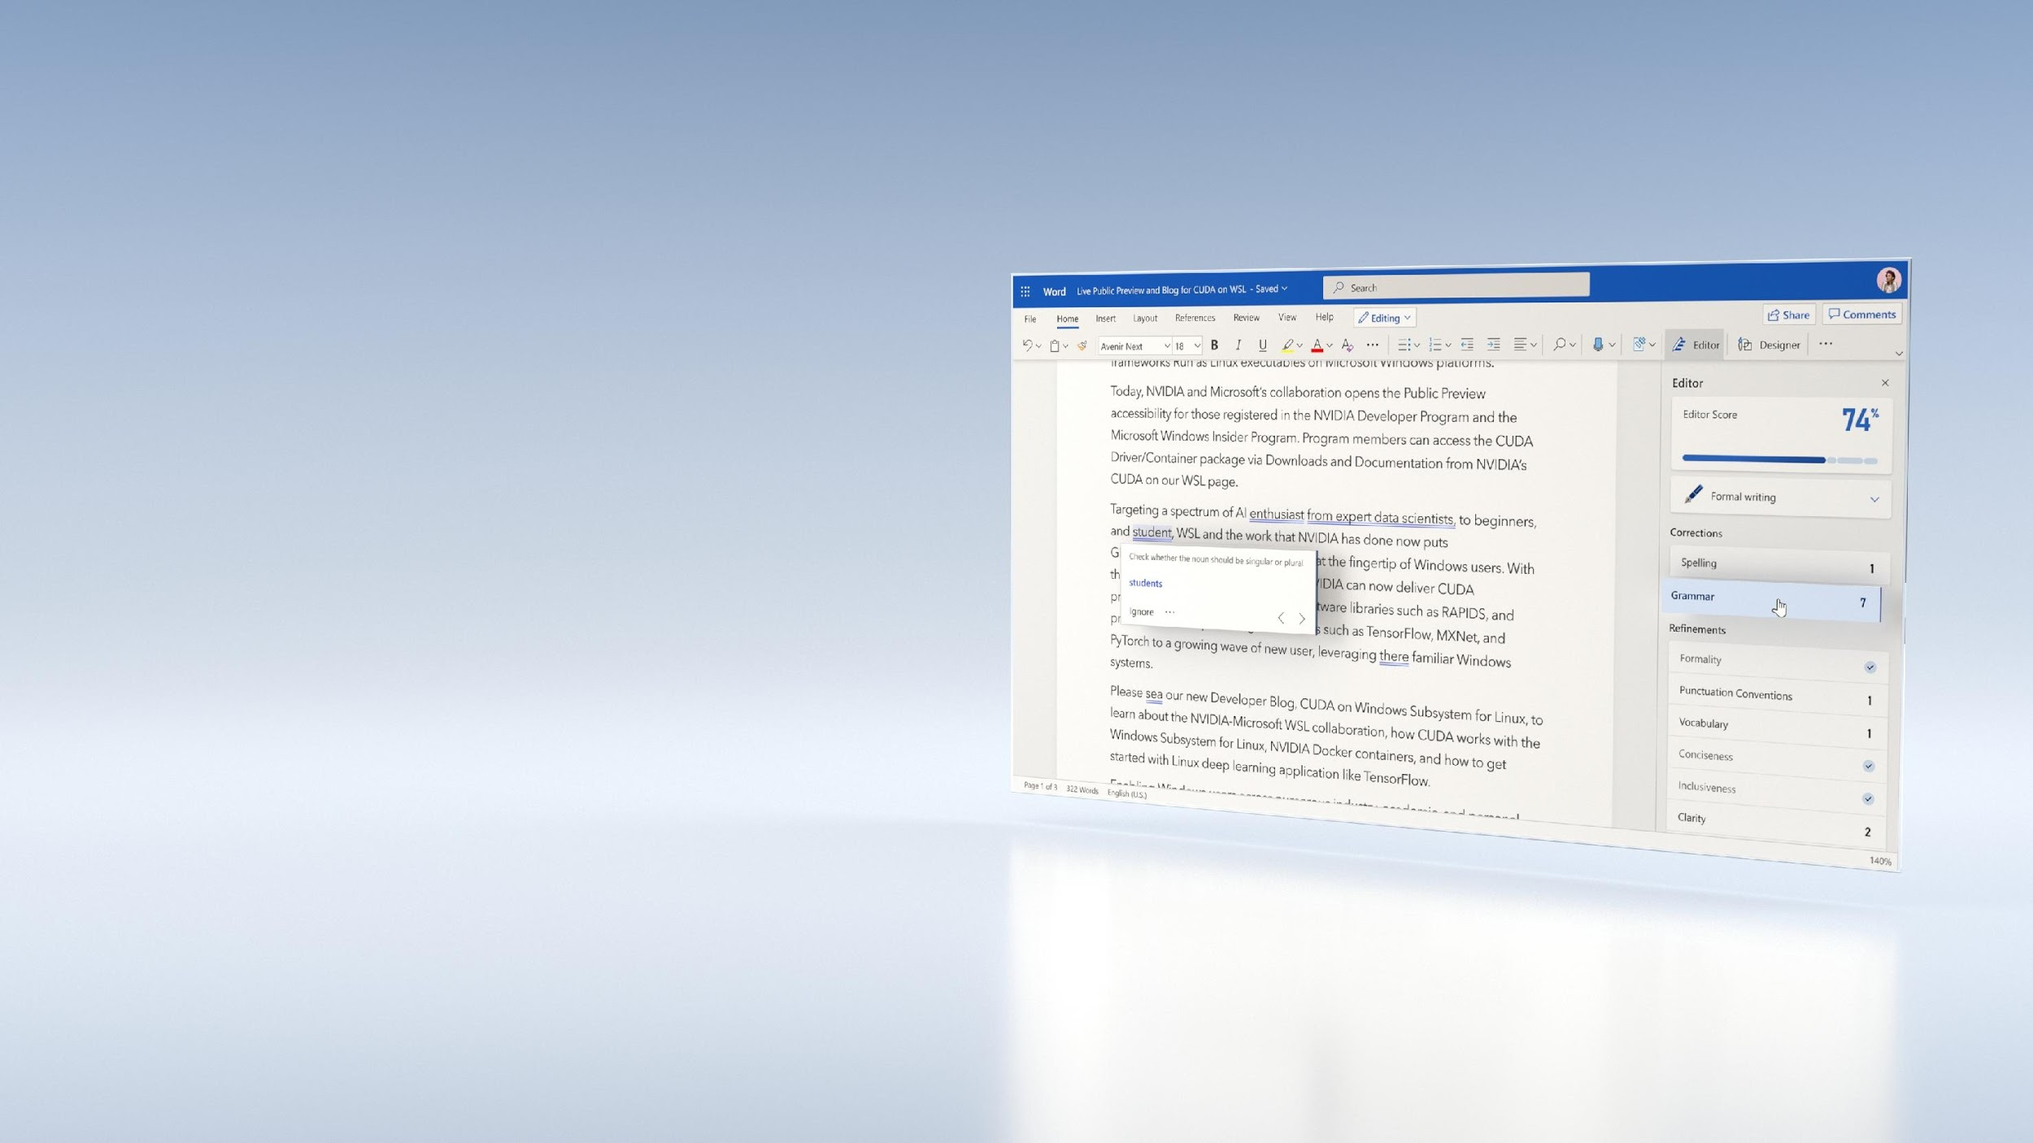
ANNOUNCING MICROSOFT ADOPTS NVIDIA AI TO CREATE SMART EXPERIENCES IN MICROSOFT OFFICE
Correct Grammar | Q&A | Predict Text
200ms Inference Response for SOTA AI
1/3rd Lower Cost Than CPU
Azure ML & ONNX Runtime with Triton for Inference Serving
Half a Trillion Queries per Year for Grammar
Link to Announcement
Microsoft Blog

Slide 29

ANNOUNCING AMERICAN EXPRESS ADOPTS NVIDIA AI TO PREVENT FRAUD AND FOIL CYBERCRIME
Over $1 Trillion in Transactions | 115M Credit Cards
8 Billion Highly Accurate AI-Powered Decisions per Year Lower Fraud Losses
<2ms Latency Enables Real-Time Fraud Detection
Amex’s Advanced ML Capabilities Combined with NVIDIA AI
Trained on DGX | Optimized with TensorRT | Inference Serving with Triton
Link to Announcement

Slide 30
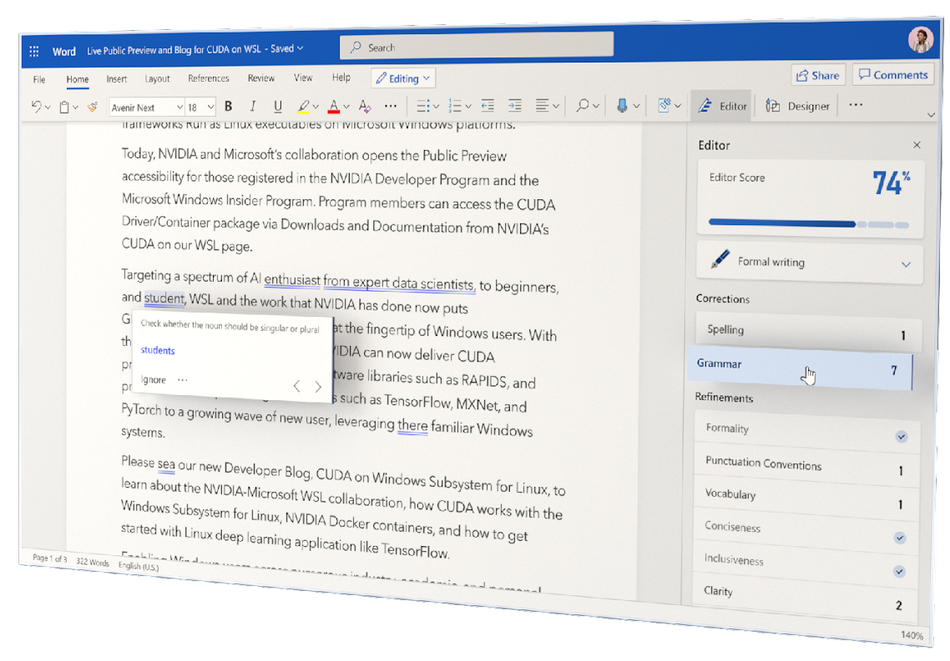
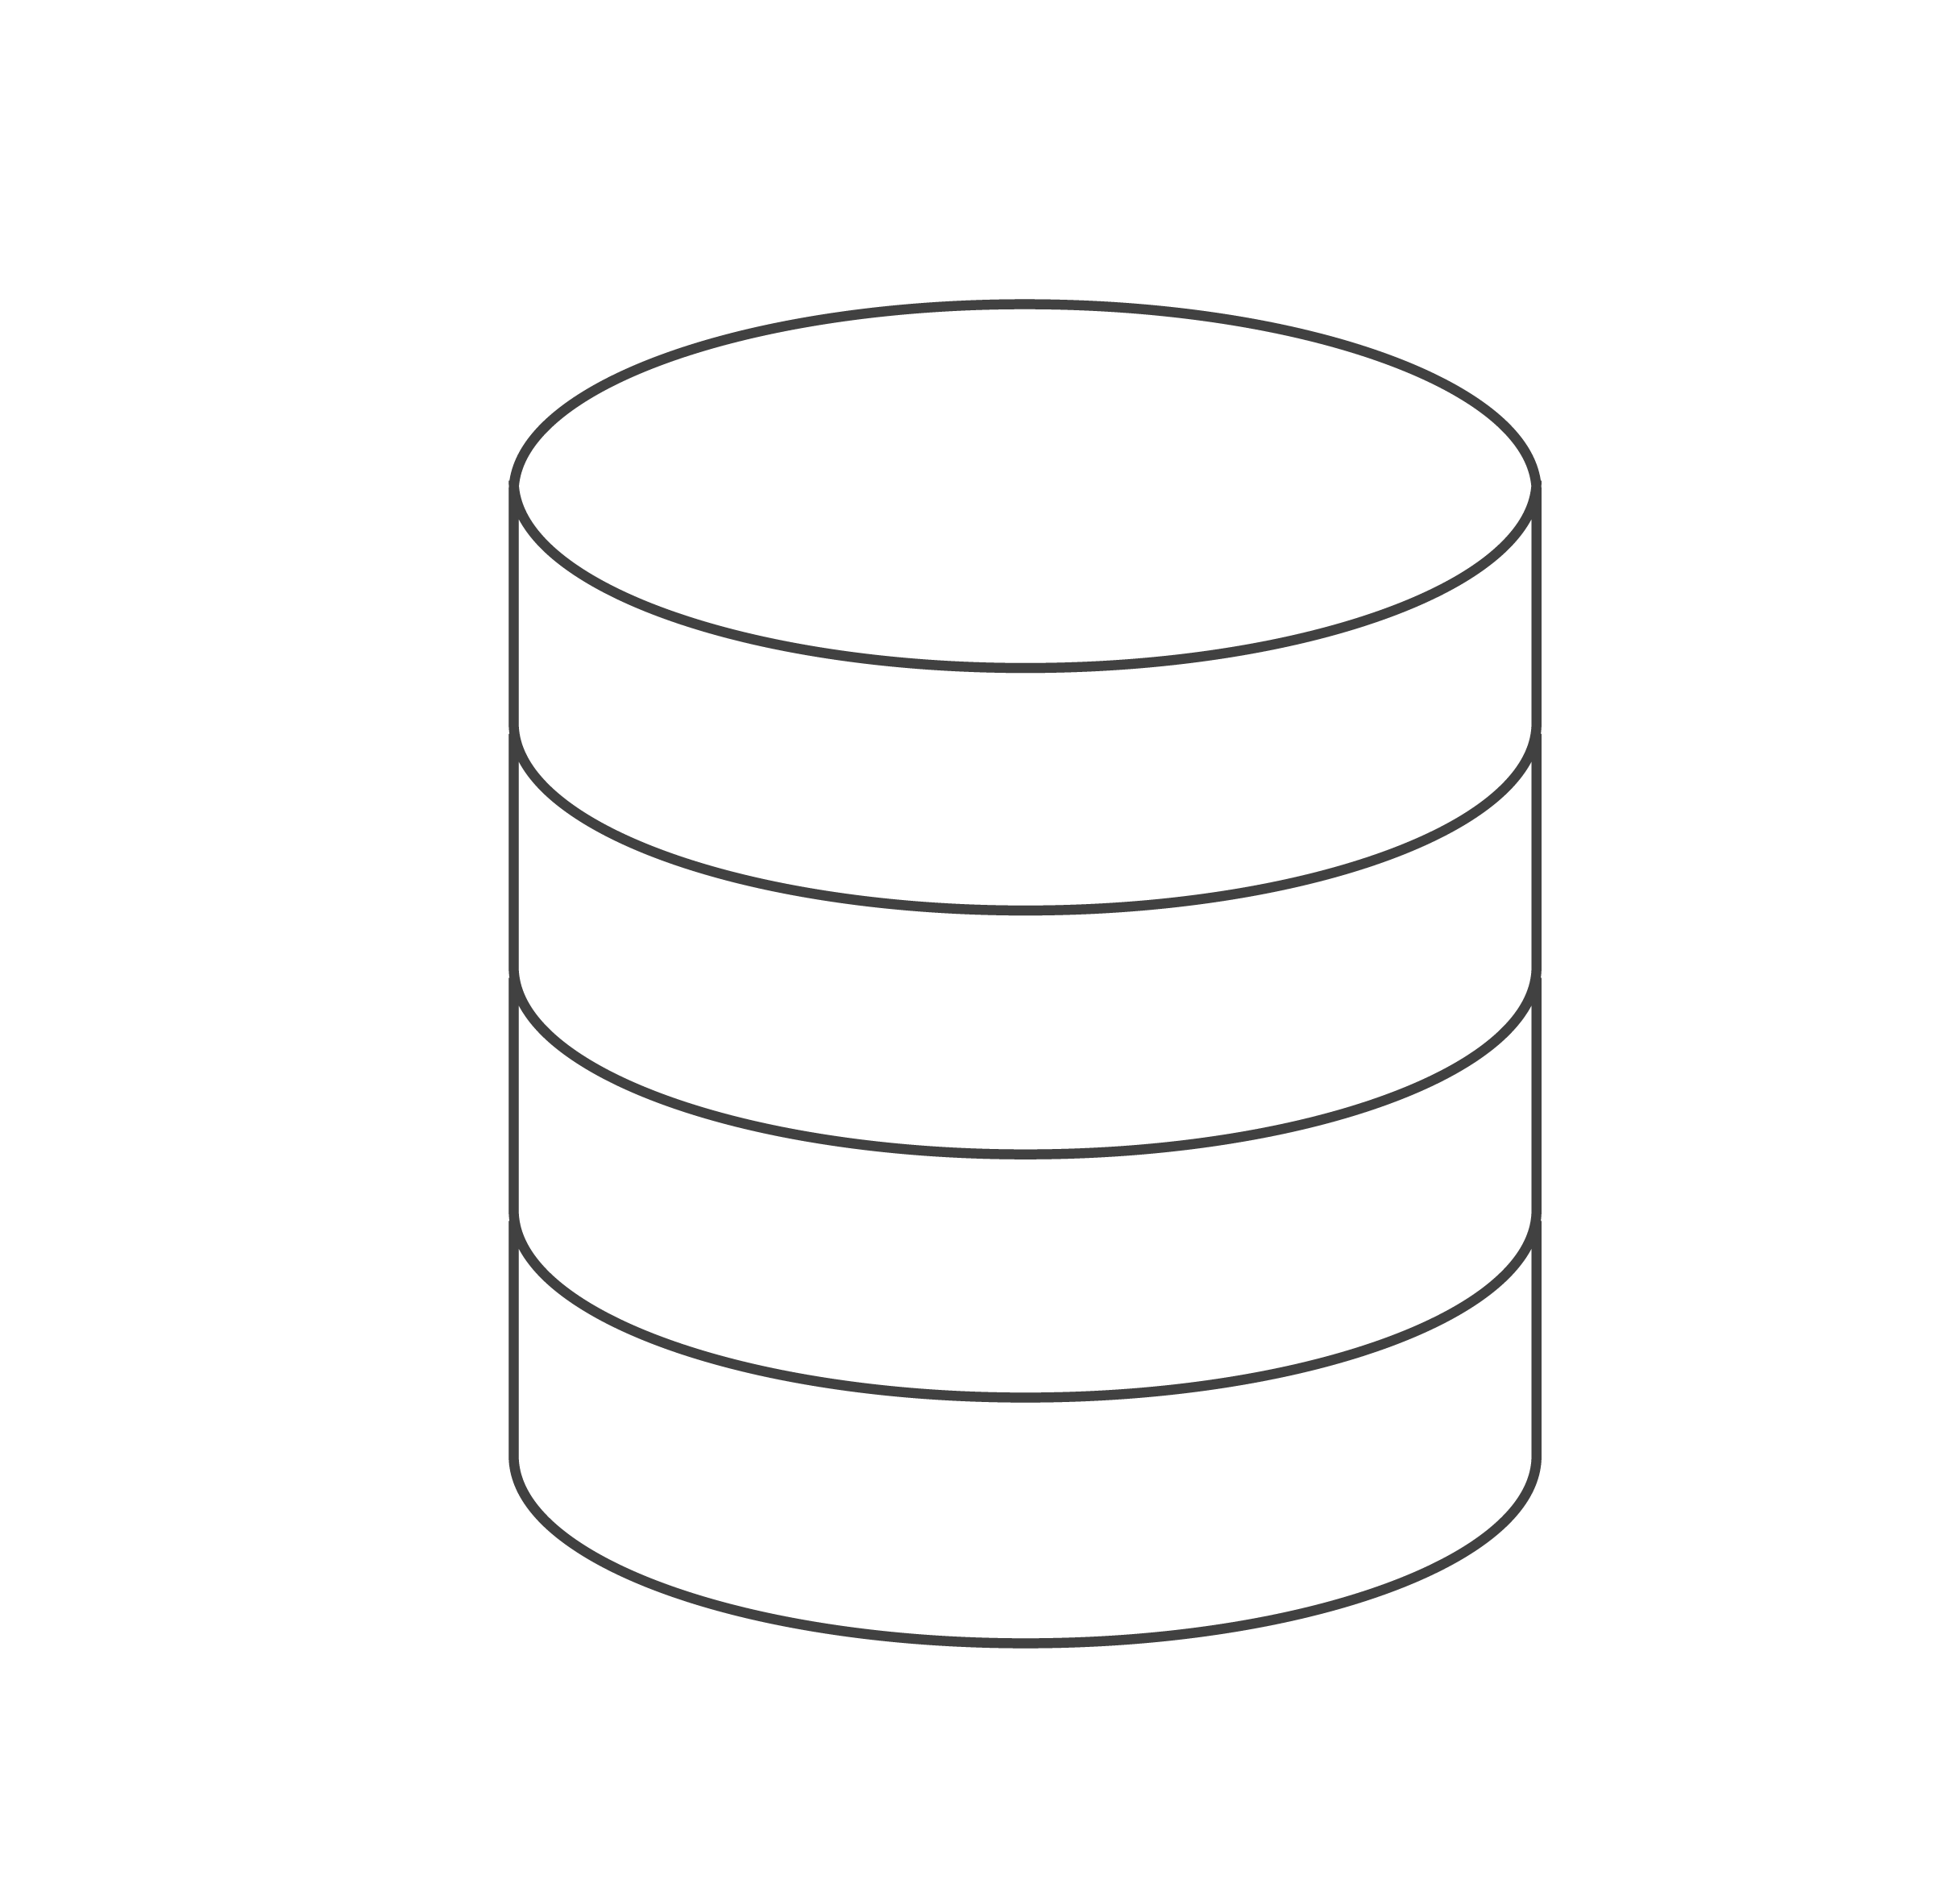
NVIDIA AI ON MICROSOFT AZURE MACHINE LEARNING TO POWER GRAMMAR SUGGESTIONS IN MICROSOFT EDITOR FOR WORD
Microsoft Word Online
Grammar Check
Query
Triton
Seq2Seq
Corrected Spelling /
Sentence
100’s of Millions of Users
Azure V100 GPU
GRAMMAR CORRECTION
Half a Trillion Queries per Year
200ms Inference Response
1/3rd Lower Cost Than CPU
Infrastructure: Azure ML, V100 GPUs, Backend: ONNX Runtime, Inference serving: Triton

Slide 31


AMERICAN EXPRESS ADOPTS NVIDIA AI TO HELP PREVENT FRAUD AND FOIL CYBERCRIME
Transaction Record + Customer Info, Vendor History
Triton
LSTM
Fraud Assessed in <2 ms
Final Score
Fraud Risk
Ranking
T4 GPU
FRAUD PREVENTION
Over $1 Trillion in Transactions | 115M Credit Cards
2ms Latency Enables Real-Time Fraud Detection (50x improvement compared to CPUs)
Up to 6% Higher Accuracy in Specific Segments
Training: DGX, Inference backend: TensorRT, Inference serving: Triton

